Slide 1
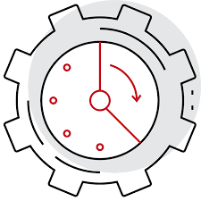
TEAM 13 Machine Failure Detection
Team Members:
Muhilan H
Nithyleshwaran
Karan Singhania
Shri Venkatakrishnan
Syed Fareed

Slide 2
Motivation/Significance
Cost Reduction: Predicting machine failures in advance allows for planned maintenance and reduces the likelihood of unexpected breakdowns. This leads to cost savings by preventing costly emergency repairs and downtime
Operational Efficiency: Predictive maintenance optimizes the scheduling of maintenance activities, reducing machine downtime and improving overall operational efficiency. Businesses can maintain a continuous, uninterrupted workflow, which is crucial for production-oriented industries

Slide 3
Dataset Descriptions
The synthetic dataset describes the artificially generated data rather than collected from real-world observations or measurement of machine failures that could be encountered.The dataset consists of 136429 rows and 14 columns.
1) id: uniquely defines each rows.
2)Product ID: describes the serial number of the recorded machine
3)Type: Consists of letters L(low),M(medium),H(high) describing the quality of the particular product.
4)Air temperature[K]: Describes the room temperature of the machine.
5)Process temperature[K]:Describes the processor temperature of the machine.
6)Rotational speed[rpm]:The speed at which the cooling fan runs.
7)Torque[Nm]: Torque of machine during the process.
8)Tool wear[min]:Usage of machine during process.
9)Machine failure: 0:machine is working. 1:machine is not working.

Slide 4
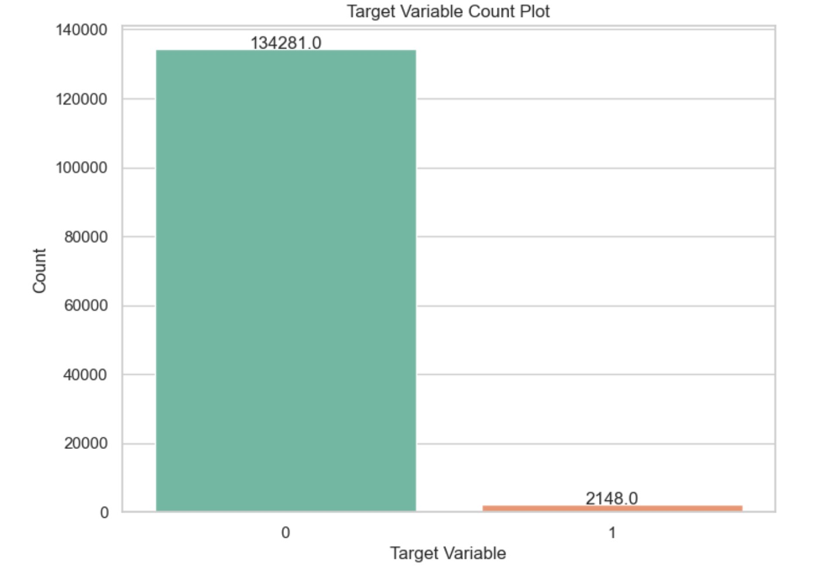
Important Observations
Model Bias: Machine learning models tend to be biased toward the majority class, as they aim to minimize the overall error. In this case, the "no failure" class is the majority class, and the model may not perform well in identifying the minority class, i.e., "machine failures.”
Sensitivity: Imbalanced datasets often result in models with reduced sensitivity or recall for the minority class. This means the model may not effectively detect machine failures, which could be a critical issue in applications where identifying failures is essential.
Evaluation Metrics: Traditional evaluation metrics like accuracy can be misleading. Even a model that predicts "no failure" for all samples would achieve high accuracy due to the class imbalance, but it wouldn't be useful.

Slide 5
Process Flow
Dataset Analysis
Feature Selection and Engineering
Standardization
Training
Cross Validation
Testing
Cross Validation
Hyper Parameter Tuning

Slide 6
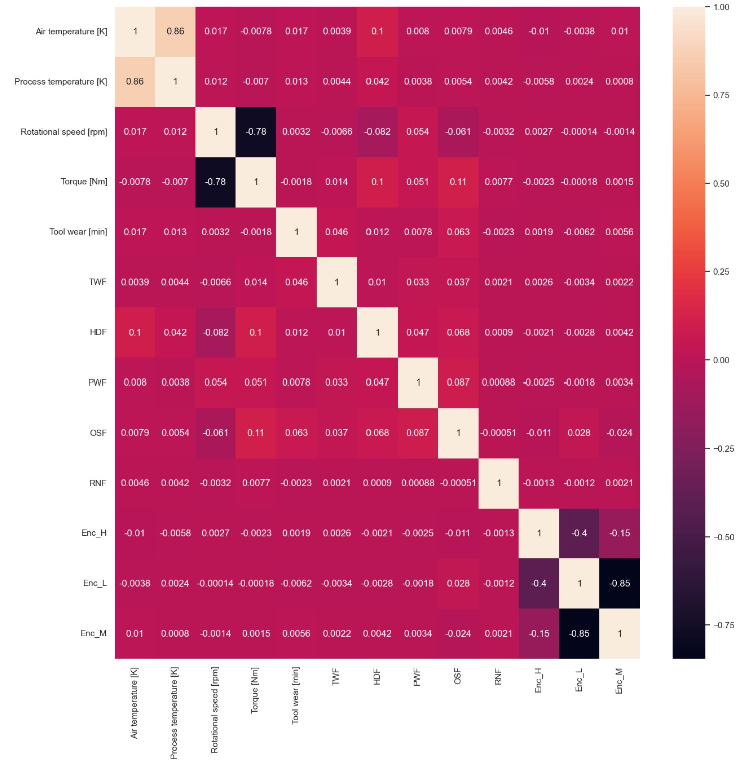
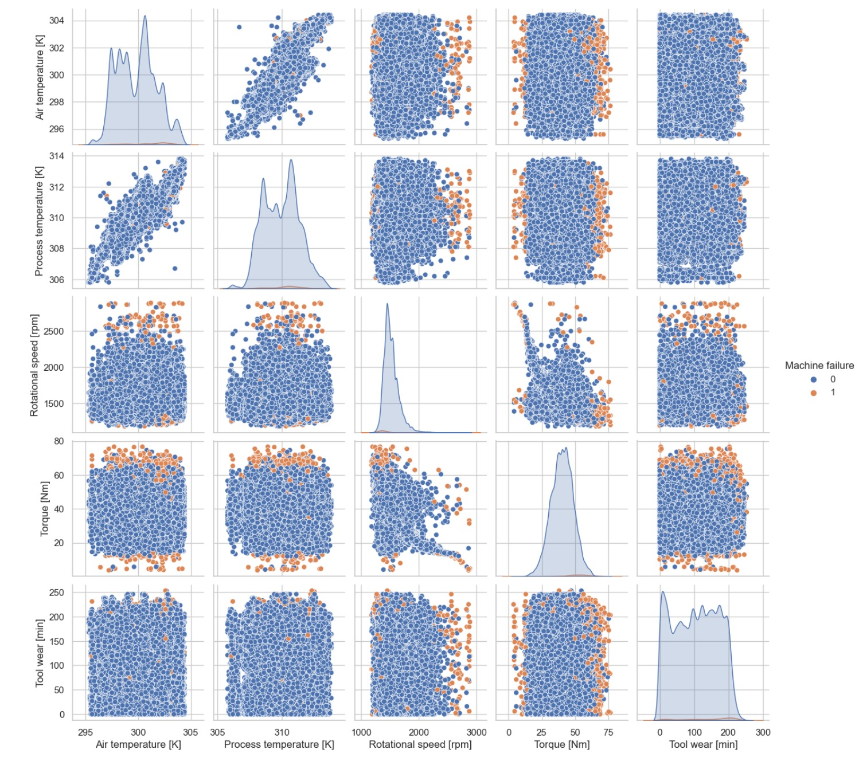
Visualization using Heatmaps

Slide 7
Feature Selection and Engineering
Columns “Product ID” and “id” were removed
3 new features were added
Temp Ratio
Process Temperature [K] / Air Temperature [K]
Temp Difference
Process Temperature [K] - Air Temperature [K]
Power
Torque [Nm] * Rotation Speed [rpm]

Slide 8
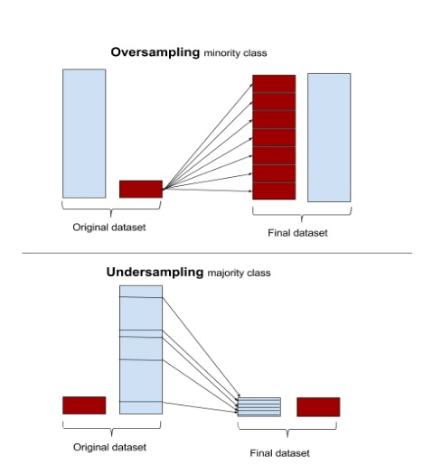
How we have tackled the dataset imbalance
Over Sampling
Increase the number of instances in the minority class by generating synthetic samples or replicating existing ones. Popular oversampling methods include SMOTE (Synthetic Minority Over-sampling Technique)
Under Sampling
Reduce the number of instances in the majority class by randomly or strategically selecting a subset of them. Be cautious with undersampling as it can lead to a loss of information.

Slide 9
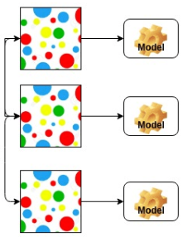
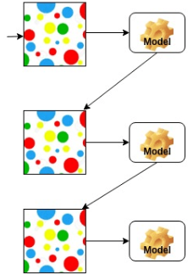
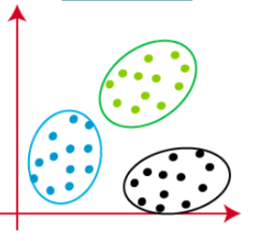
Models used for this dataset
Probabilistic Model
Ensemble (Boosting)
Unsupervised Learning
Naïve Bayes ( Used bagging technique additionally)
AdaBoost
Gradient Boosting
CatBoost
K-Means
Agglomerative Clustering

Slide 10
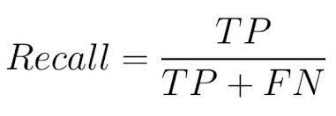
Metric
The metric most useful for this case will be RECALL SCORE:
This is because the error of more importance to us is when the model predicts it as NOT A FAILURE but it actually is FAILURE
And hence we will be paying attention to RECALL SCORE in both K-Fold cross Validation and for comparison of all models
Other metrics used : Accuracy , Precision and F1-Score, Sensitivity,

Slide 11
PCA
Hyperparameter:
n_components:
Number of components where varied from 10 till 13 and the best random forest algorithm was applied
Before PCA
Metric | Accuracy | Precision | Recall | F1_score
Value | 0.995 | 0.763 | 0.970 | 0.854
After PCA ( n = 12 and 13) we achieved an improvement in recall)
After PCA there was no improvement in f1_score !!
Recall
0.975855

Slide 12
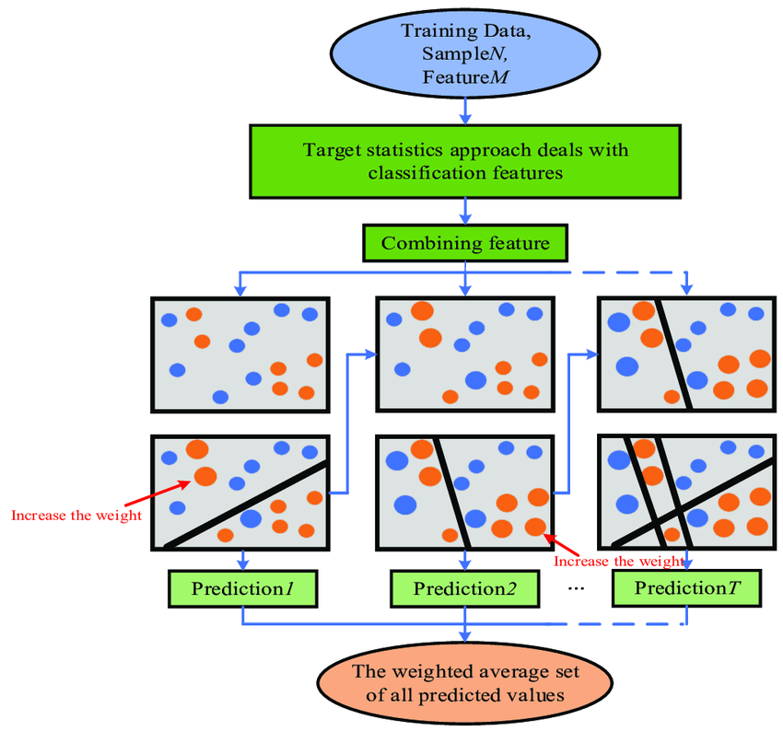
Catboost
CatBoost introduces a novel algorithm called ordered boosting that optimizes the learning objective function by permuting the features in a specific order
Hyperparameter
Border_count:This hyperparameter specifies the number of splits for numerical features.
Learning_rate: The number of boosting iterations or trees to be built.
Iterations: The number of boosting iterations or trees to be built.
L2_leaf_reg: L2 regularization term on weights

Slide 13
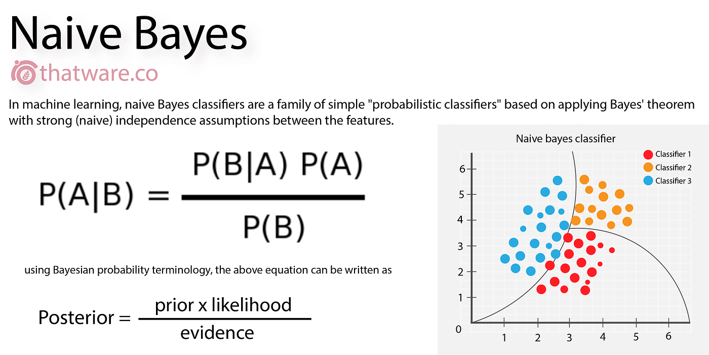
Naïve Bayes
Multiple subsets of the original dataset are randomly selected with replacement. A Naive Bayes model is trained independently on each of these bootstrap samples.
Predictions from each Naive Bayes model are combined, typically by taking a majority vote.
Hyperparameter
n_estimators :It specifies how many times the training process is repeated.
The combination of multiple Naive Bayes models, each trained on a different subset of data, helps reduce overfitting and improves the overall stability and accuracy of the model

Slide 14
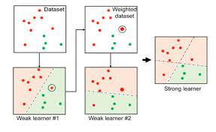
Adaboost
AdaBoost, short for Adaptive Boosting, is an ensemble machine learning algorithm that can be used in a wide variety of classification and regression tasks.
It is a supervised learning algorithm that is used to classify data by combining multiple weak or base learners (e.g., decision trees) into a strong learner.
Hyperparameters:
n_estimators:It specifies how many times the training process is repeated.
learning_rate: The number of boosting iterations or trees to be built.

Slide 15
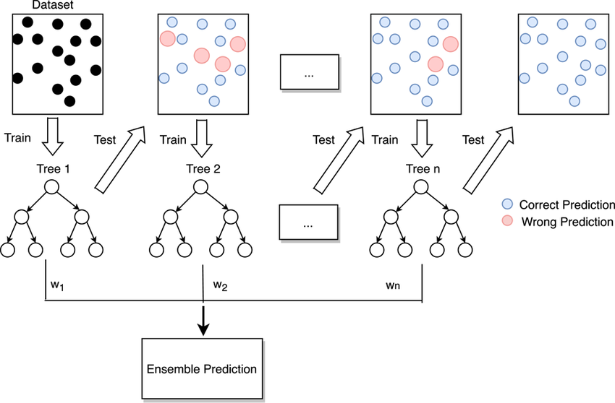
Gradient Boosting
Gradient Boosting builds trees sequentially, with each tree focusing on the mistakes made by the ensemble of the previous trees. It assigns higher weights to the instances that were misclassified by the previous trees.
It focuses on residual probabilities
(predicted_prob – actual_prob)
Hyperparameters:
n_estimators: Number of trees
max_depth: The depth of each tree to ensure less overfitting
max_leaf_nodes: Max leaf nodes of each decision tree

Slide 16
Unsupervised Learning
Model | Accuracy | Precision | Recall | F1 Score
K-Means | 0.5047 | 0.2841 | 0.0091 | 0.0177
Agglomerative Clustering | 0.5355 | 0.6562 | 0.0223 | 0.0432
Conclusion: Unsupervised models are not suitable for our use-case. There isn’t any underlying similarities between rows (after conversion into points in n-dimensional space) corresponding to a class.

Slide 17
Performance and Results
Under Sampling
As we can observe from the graph and table, ranking by both recall and f1_score we get:
Adaboost
Gradient Boosting
Naïve Bayes (with bagging)
Catboost
Model | Accuracy | Precision | Recall | F1 Score
Naïve Bayes (With Bagging) | 0.9936 | 0.7789 | 0.8422 | 0.8093
AdaBoost | 0.9265 | 0.8575 | 0.9614 | 0.9065
Gradient Boosting | 0.9194 | 0.8403 | 0.9606 | 0.8964
Cat Boosting | 0.5609 | 0.8685 | 0.5467 | 0.6711

Slide 18
Performance and Results
Oversampling
Model | Accuracy | Precision | Recall | F1 Score
Naïve Bayes | 0.8419 | 0.6845 | 0.901 | 0.8125
AdaBoost | 0.900 | 0.8537 | 0.9407 | 0.8951
Gradient Boosting | 0.8987 | 0.8573 | 0.9345 | 0.8943
Cat Boosting | 0.8904 | 0.8423 | 0.9320 | 0.8849
As we can observe from the graph and table, ranking by recall and f1 score we get:
Adaboost
Gradient Boosting
Catboost
Naïve Bayes (with bagging)

Slide 19
Performance and Results
Normal (After Hyperparameter Tuning)
Model | Accuracy | Precision | Recall | F1 Score
Naïve Bayes | 0.9966 | 0.7995 | 0.9880 | 0.8852
AdaBoost | 0.9661 | 0.7605 | 0.9938 | 0.8617
Gradient Boosting | 0.9958 | 0.7621 | 0.9643 | 0.8513
Cat Boosting | 0.9960 | 0.7518 | 0.9925 | 0.8556

Slide 20
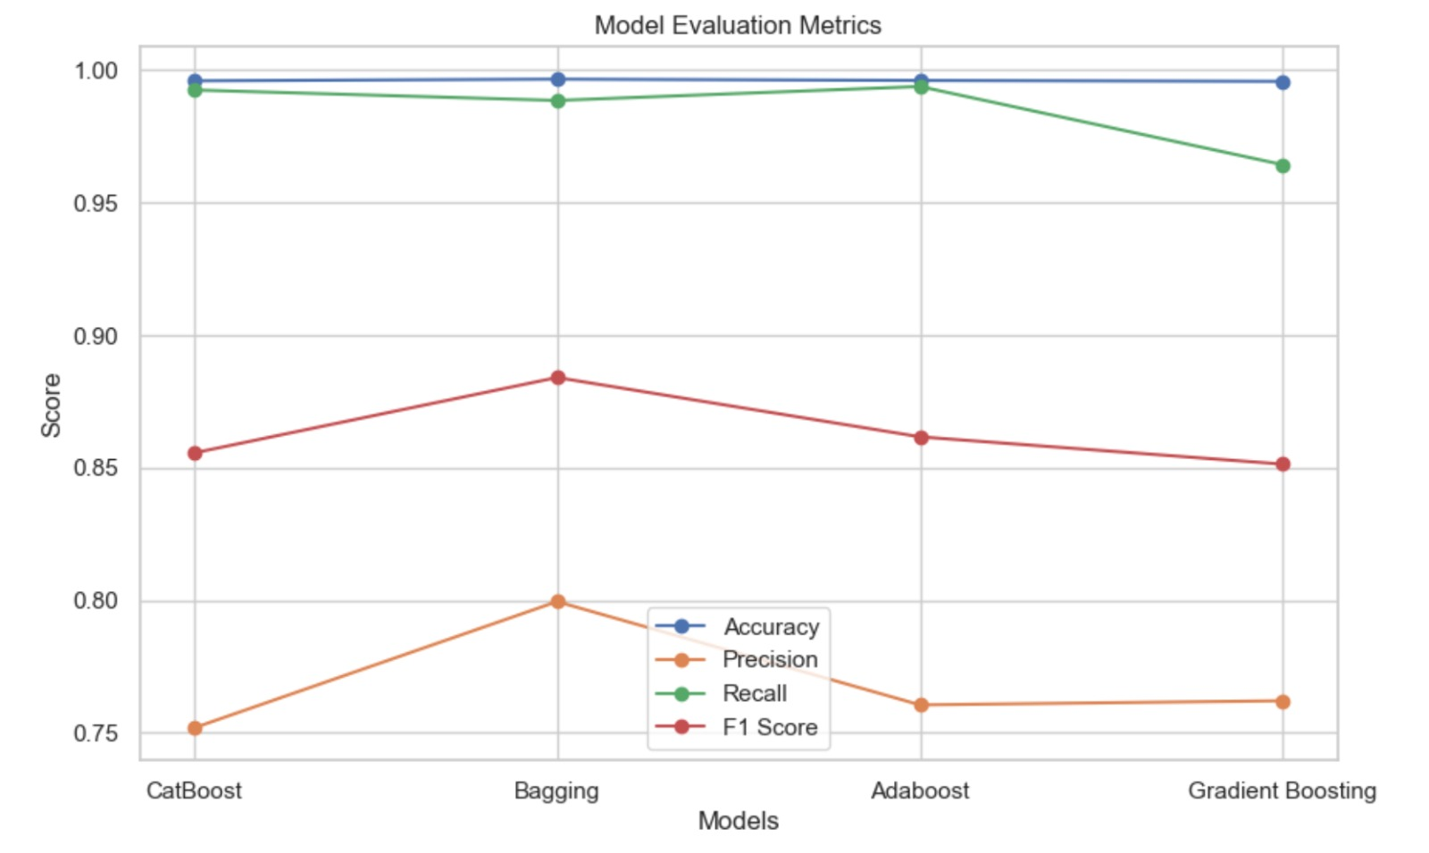
Evaluation Metrics Graph (Normal after HPT)
As we can observe from the graph and table, ranking by f1_score we get:
Naïve Bayes (with bagging)
Adaboost
Catboost
Gradient Boosting

Slide 21
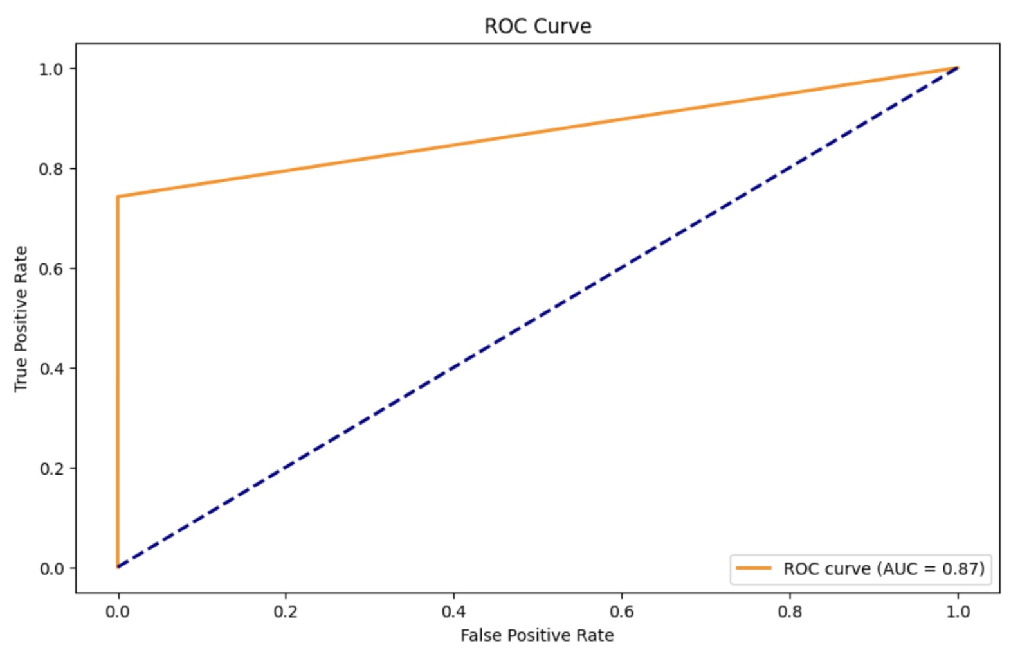
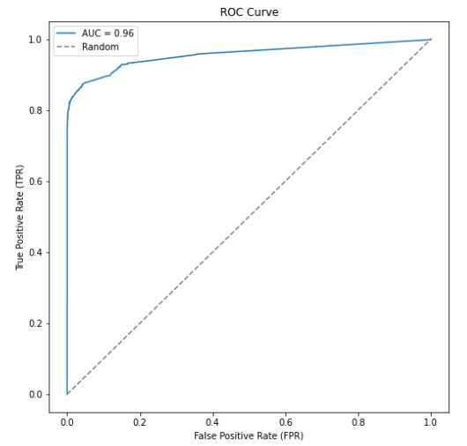
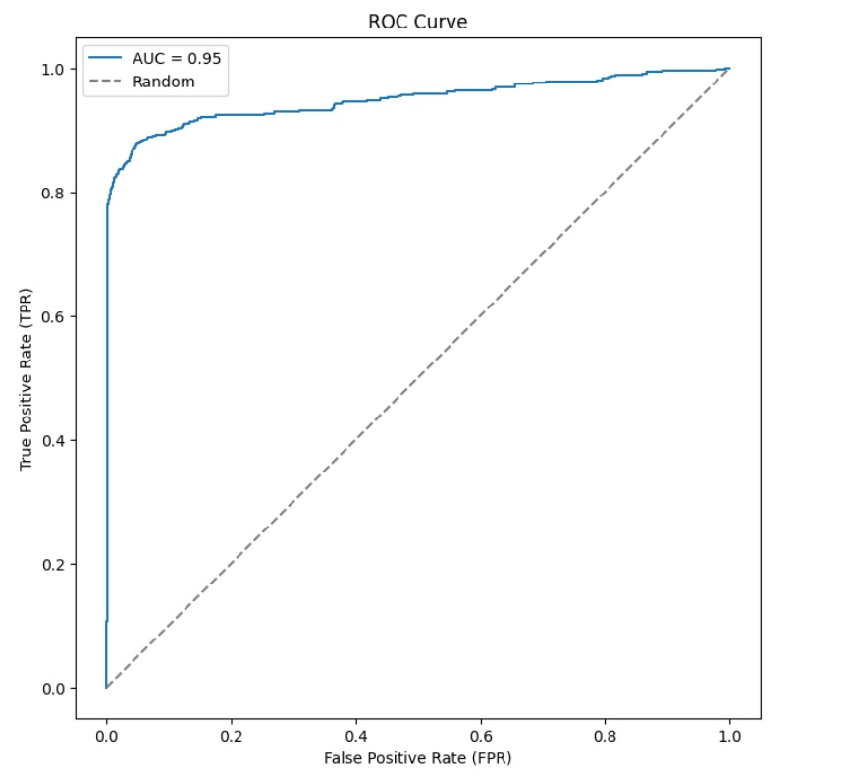
ROC – AUC Curves
CatBoost
Adaboost
Naïve Bayes with Bagging
Gradient Boosting

Slide 22
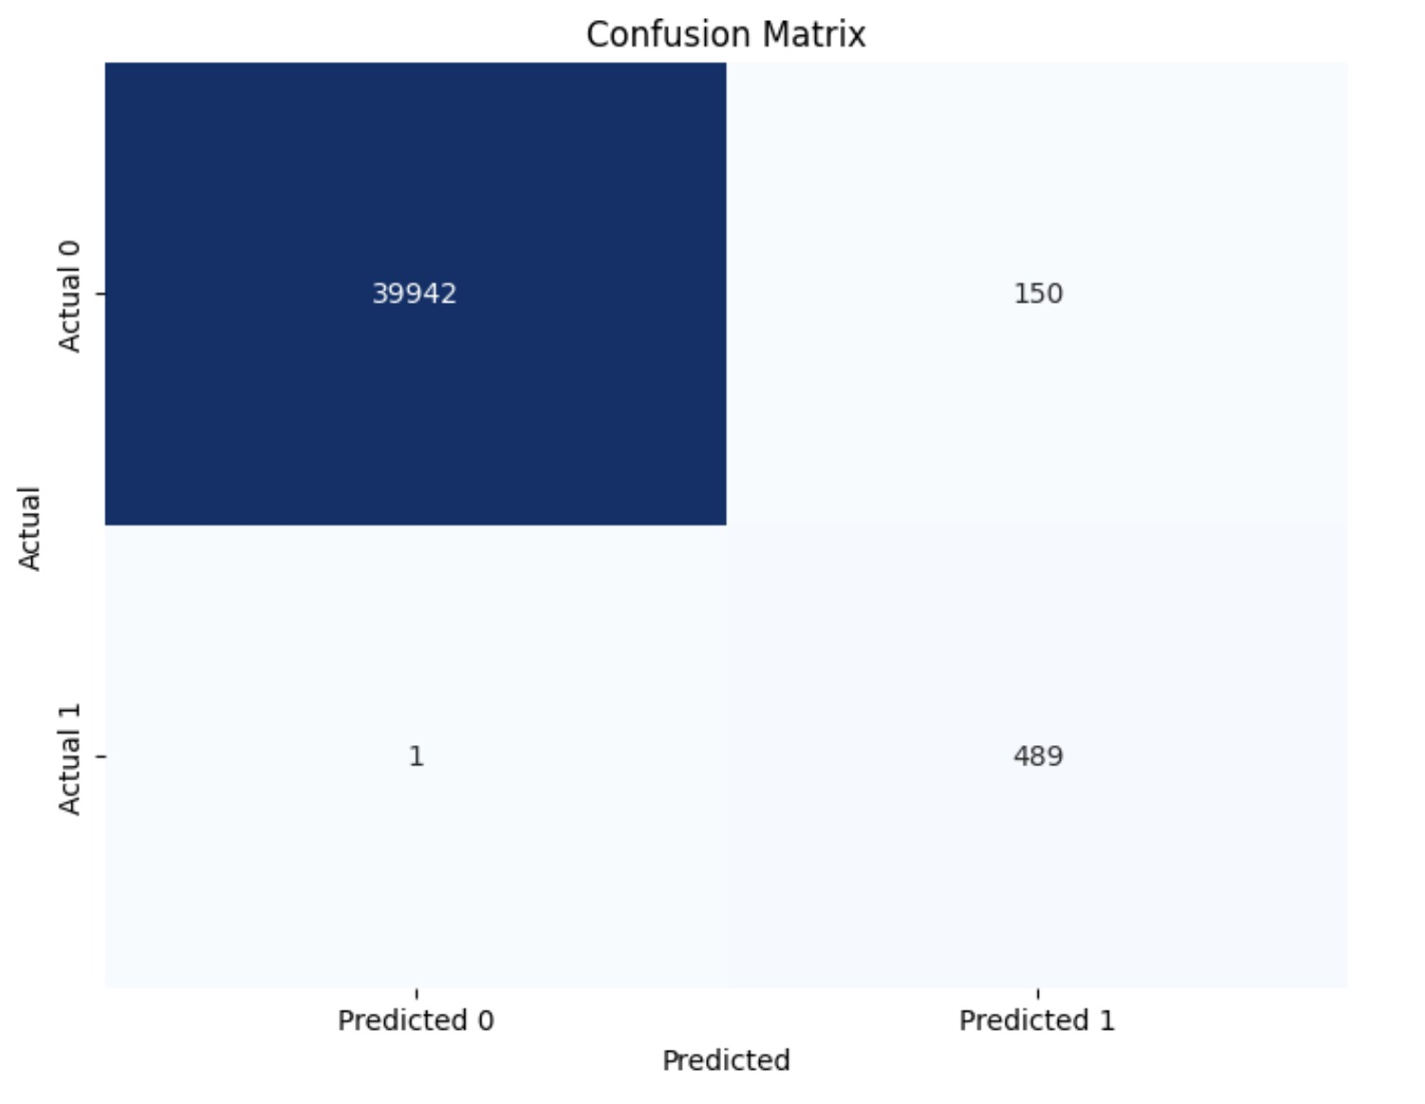
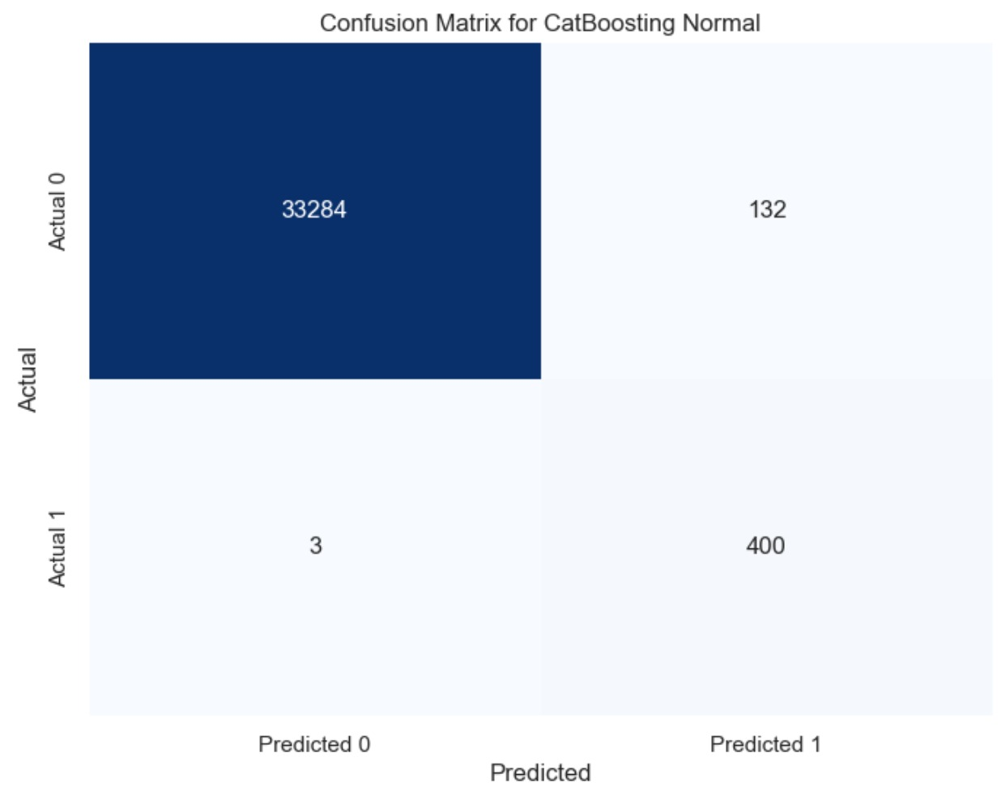
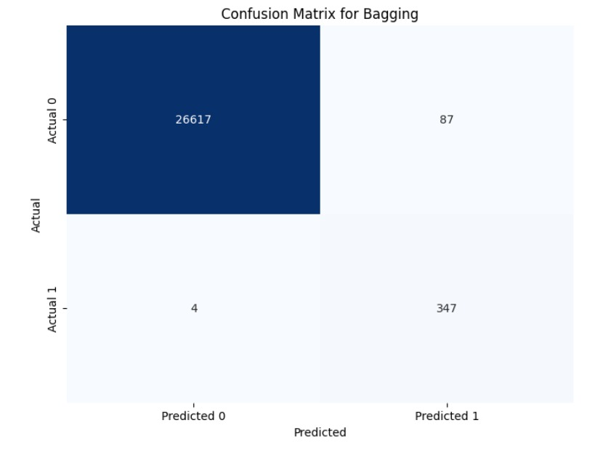
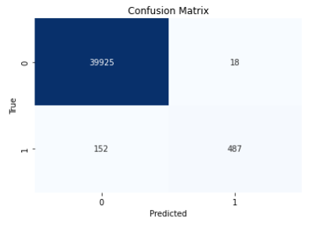
Confusion Matrices
Adaboost
CatBoost
Naïve Bayes with Bagging
Gradient Boosting

Slide 23
Performance and Results
Comparing Average Recall after Cross Validation
 | Naïve Bayes | Adaboost | Gradient Boosting | Cat Boosting
Avg. Recall | 0.7613 | 0.7426 | 0.7695 | 0.7687
Hence ranking by recall, which is the most important metric for our use case:
Gradient Boosting
Cat Boosting
Naïve Bayes
Ada Boost

Slide 24
Performance and Results
Normal (After Hyperparameter Tuning and PCA)
Model | Accuracy | Precision | Recall | F1 Score
Naïve Bayes | 0.9796 | 0.7235 | 0.4220 | 0.5331
AdaBoost | 0.9161 | 0.7305 | 0.7838 | 0.8517
Gradient Boosting | 0.9953 | 0.7511 | 0.9448 | 0.8369
Cat Boosting | 0.9956 | 0.9683 | 0.7481 | 0.8441
Recall has decreased drastically across all models
Precision increases for Gradient Boosting alone

